Slide 1
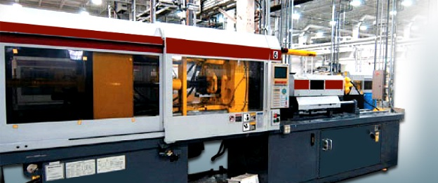
Metal Processes
Mr. Maiseroulle

Slide 2
Common Casting Types
Green-Sand Mold Casting
Full-Mold Casting
Investment Casting

Slide 3
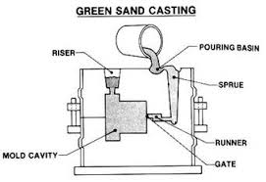
Green-Sand Casting
Oldest method of casting
Accounts for about 80% of castings
High Flexibility
Allow gases to escape during pour
Easily Produced
Uses clay binder

Slide 4
Terminology of Green-Sand Casting
Flask – Holds the sand/mold
– Drag – Bottom part of flask
– Cope – Top half of flask
Sprue – Vertical channel used to get molten metal to part cavity
Runner/Gate – Horizontal channel to get molten metal to part cavity
Vents – small (wire size) channels to allow for gas escape
Patterns – form part cavity
Cores – allow for hollow areas in casting

Slide 5
Full Mold Casting
Also called “lost foam casting”
Uses expandable polystyrene
Foam part with sprues, gates and runners are place in a tight sand
Metal vaporizes foam and fills cavity
Advantages
– Complex parts
– Patterns are cheap
– Large parts
– Single or short run castings

Slide 6
Investment Casting
Uses wax patterns
Patterns are clustered to a sprue
Pattern is dipped into a refractory slurry to create a hard shell
The wax is melted out of the a mold.
The hollow mold is filled with metal and the mold is destroyed.
Advantages:
– Complex shape
– Accuracy
– Can be used with material difficult to machine
– Fine surface finish

Slide 7
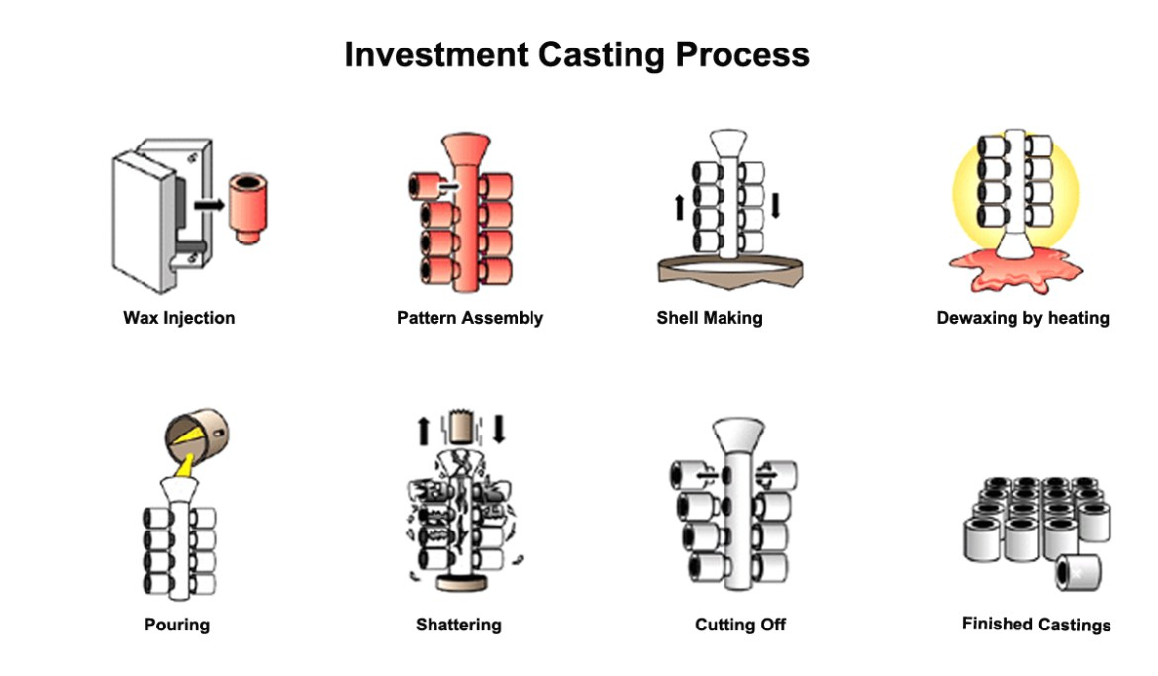
Investment Casting

Slide 8
Bonding Metal
Pressure Bonding:
– Spot Welding (resistance welding)
Electrical current
Fusion Bonding:
– Arc, oxyacetylene, plastic welding, MIG
Flow Bonding:
– Uses a metal alloy
- Brazing
- Soldering
- Aluminum Welding
Mechanical Fastening
– Pop rivets
– Screw
– Bolts

