Slide 1
Materials and Processes

Slide 2
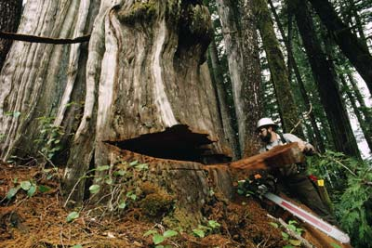
Raw Materials
Organic materials like wood come from living organism like trees.
Inorganic materials like metal come mineral deposits like iron ore.
Obtaining Materials
Harvesting
Extracting

Slide 3
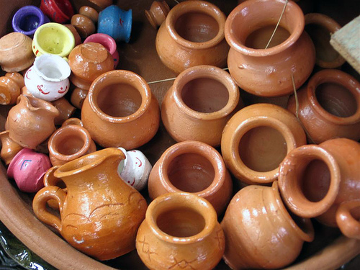
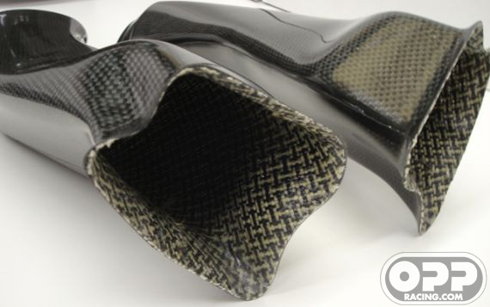
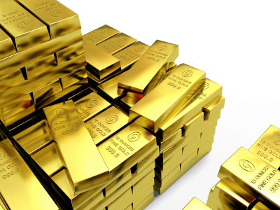
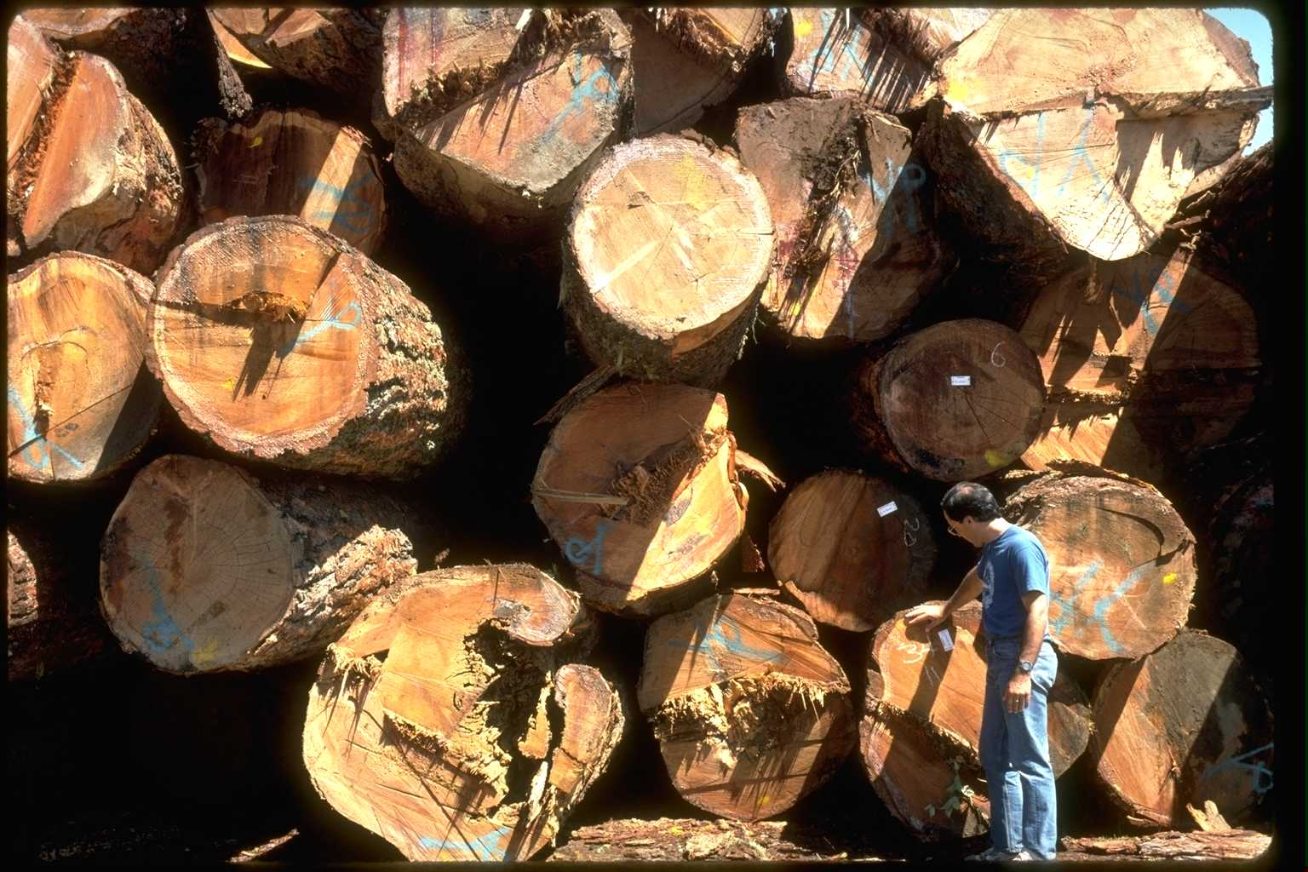
Commonly used materials
Polymers
Metals
Ceramics
Composites

Slide 4
Polymers
NATURAL
SYNTHETIC
Wood
Cotton
Rubber
Silk
Plastics
Thermosets
Thermoplastics

Slide 5
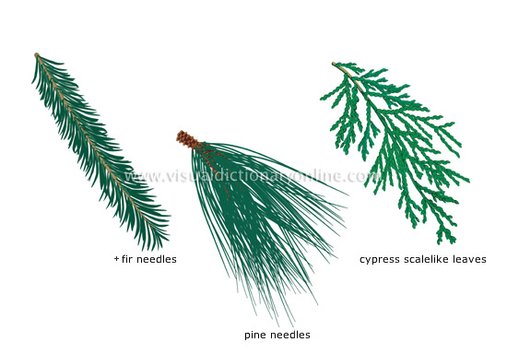
Wood
Gymnosperms – Conifers
yield lumber called “Softwood”
Needlelike or Scalelike foliage
Keep foliage year round
Cone bearing
Excurrent – Dominant main trunk with lateral branches

Slide 6
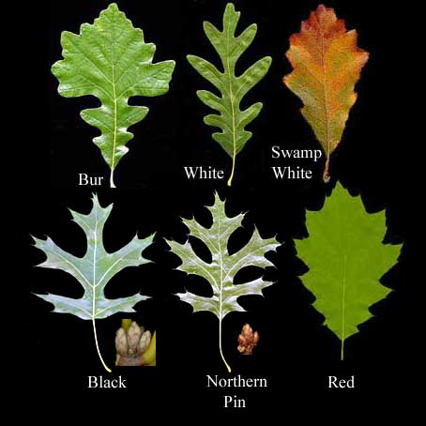
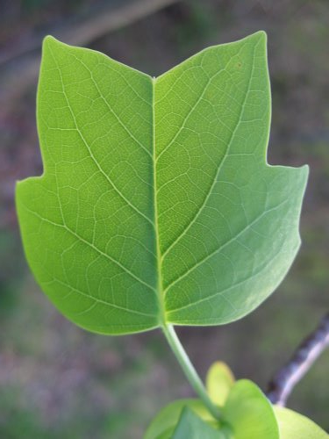
Wood
Angiosperms – Deciduous
Yield lumber called “Hardwood”
Broad-leafed foliage
Lose foliage during winter
Seed producing
Dendritic – Branching or rebranching of the main trunk

Slide 7
Wood
Moisture Content – The amount of water/moisture in wood cells
Cellulose and lignin are the building blocks of wood
Hygroscopic – Material expands when it gains moisture and shrinks when it loses moisture.

Slide 8
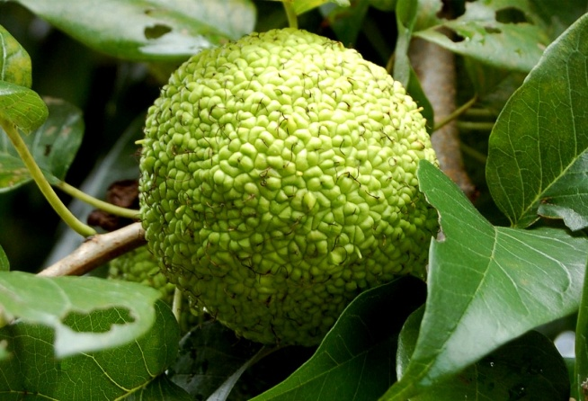
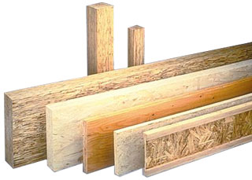
Wood Products
Solid Lumber
Oak
Osage Orange
Engineered lumber
MDF (Medium Density Fiberboard
Plywood
OSB (Oriented Strand Board
Hardboard
Particle Board

Slide 9
Materials and Processes
Plastics

Slide 10
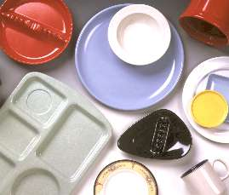
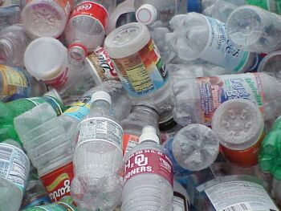
Plastics
Made up of polymers.
3 types:
Thermoplastics:
Can be heated and cooled to reshape.
Heat soften/cool harden
Polyethylene, PVC, Acrylic.
Thermosets:
Resist heat and pressure, strong bonds
Heat soften/heat harden
Epoxy, Phenolics, Polyesters, Urethanes
Elastomers:
Can stretch and return to original size.
Natural or synthetic
Rubber and neoprene

Slide 11
Plastics
Elasticity – ability of a material to return to its original shape after a stress is applied.
Yield Limit – The point when a material deforms plastically and loses its elastic ability.
Plasticity – Deformation of a material caused by an applied force.

Slide 12
Metals
Inorganic material
Expand when heated contract when cooled
Rarely used in pure form, used as alloys.
Strong, durable, tough
Ferrous & Nonferrous
Common metals:
Steel: alloy of iron and carbon
Aluminum: light weight, strong, corrosion resistant
Copper: excellent conductor of heat and electricity. Corrosion resistance

Slide 13
Metals
Ferrous
Non-Ferrous
As the most abundant of all commercial metals, alloys of iron and steel continue to cover a broad range of structural applications.
Iron ore constitutes about 5% of the earth's crust
a wide variety of mechanical properties and material characteristics.
specified for structural applications requiring reduced weight, higher strength, nonmagnetic properties, higher melting points, or resistance to chemical and atmospheric corrosion.

Slide 14
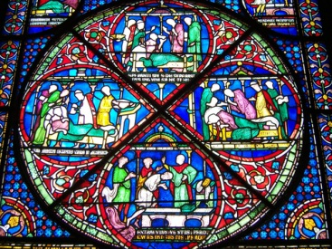
Ceramics/Earth Materials
Oldest material used.
High melting temps.
Resistant to corrosion and chemicals.
Hardest of engineering materials
Rigid and brittle
Types of ceramics:
Clay
Porcelain
Glass
Refractory

Slide 15
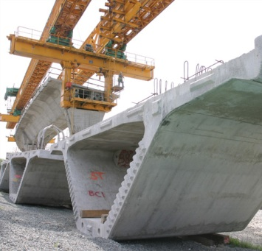
Composites
A combination of 2 or more other materials to form a new material better than the originals.
Types of composites:
Concrete
Fiberglass
Engineered wood panels
Roofing materials

