Slide 1
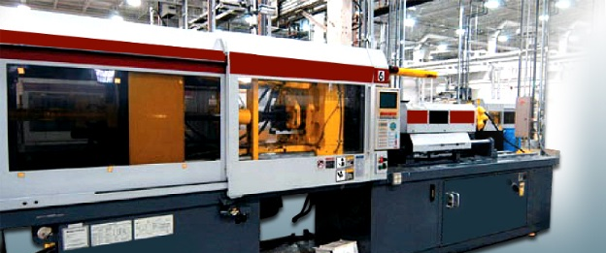
Wood processes
Mr. Maiseroulle

Slide 2
Primary processing
Harvesting Wood
Felling
Bucking
Sawmill Operations
Bandsaw
Circular Saw
Portable Saw
Drying
Pulp and Paper Manufacturing

Slide 3
Secondary processing
Forming Wood
Bonding: Using heat and pressure to compact particles
hardboard, particle board, OSB, plywood, panels
Bending
Wet Bending
Dry Bending

Slide 4
Secondary Processing
Milling: Removing material with cutting edges equally spaced either on a flat surface or round cylinder.
Hand tools: Rasp, file
Machines: Planer, router, jointer, shaper

Slide 5
secondary Processing
Abrading: removing material by wearing away with random or multipoint cutting edges.
Hand tools: Sanding block and sand paper
Machine tools: Belt sander, disk sander, drum sander Spindle, orbital portable

Slide 6
secondary processing
Sawing: Removing material using pointed cutting points equally spaced along the edge of a straight or round blade.
Hand tools: Back saw, coping saw, keyhole, crosscut, rip
Machine tools: Saber, jig or scroll saw, circular or table, radial arm, band saw

Slide 7
Secondary Processing
Drilling: Removes material using a cutting tool with two or more spiral cutting edges.
Hand Tools: Auger bit, twist drill, counter sink, forstner, brace,
Machine Tools: Drill press, portable electric drill, Mill, Mortiser

Slide 8
secondary processing
Turning: Cutting process in which a single cutting edge tool is fixed and work rotates.
Hand Tools: Gouge, parting tool, Skew, facing tool
Machine Tools: Lathe

Slide 9
secondary processing
Shearing: Cutting using a single cutting edge moving through a fixed work piece.
Hand Tools: plane, chisel, draw knife scraper
Machine Tools: Jointer, veneer slicer

Slide 10
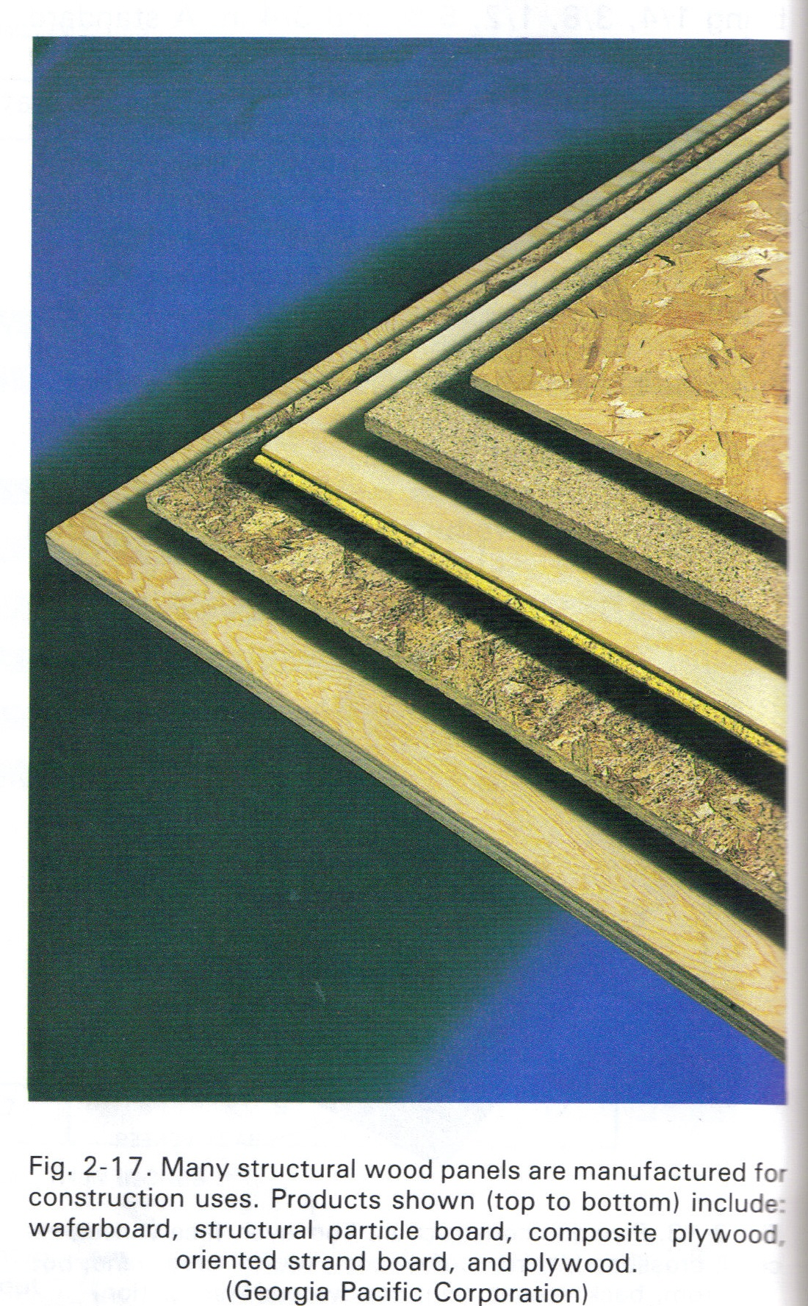
Engineered wood panels
Examples include:
Plywood
MDF
OSB
Hardboard

Slide 11
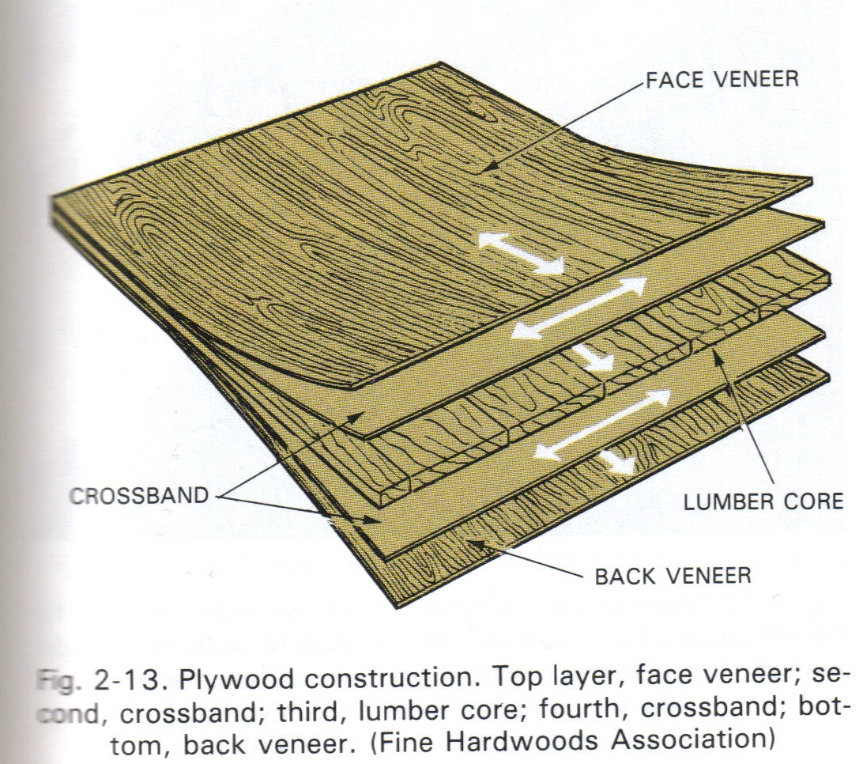
plywood
Constructed by gluing together layers (plies) of wood with the grain at right angels to each other.
Odd number of plies are used. (3,5,7)
Outer plies are called FACES (or face and back)
Next layers are called CROSSBANDS.
The other inside layer is called the CORE.
2 most common types of cores are veneer and lumber.

Slide 12
Types of plywood
2 types:
Exterior:
Interior:
Difference between the 2 is the adhesive
Plywood is available either softwood or hardwood.
4’x8’ standard size.
Thicknesses vary:
Grades: depends on the quality of the face and back veneers.

Slide 13
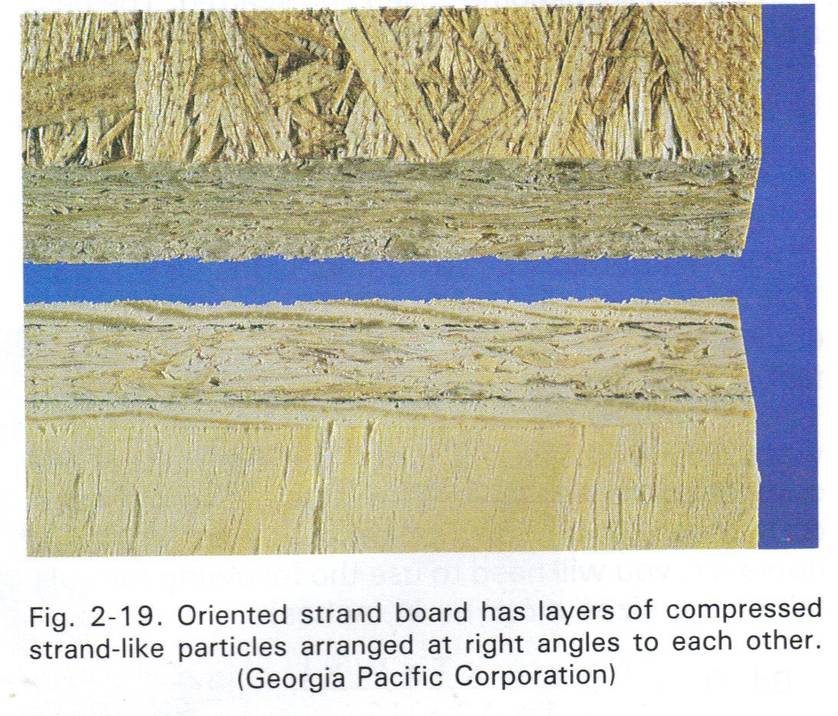
Oriented strand board
OSB
Made of wood fibers adhered to each other with suitable resins and glues.
Arranged in layers at right angles to each other.

Slide 14
Medium density fiberboard
MDF
Manufactured from a wood fiber-resin combination that is formed into a mat of random fiber orientation.
Hot press finished.
Smooth finish.
Excellent machinability

Slide 15
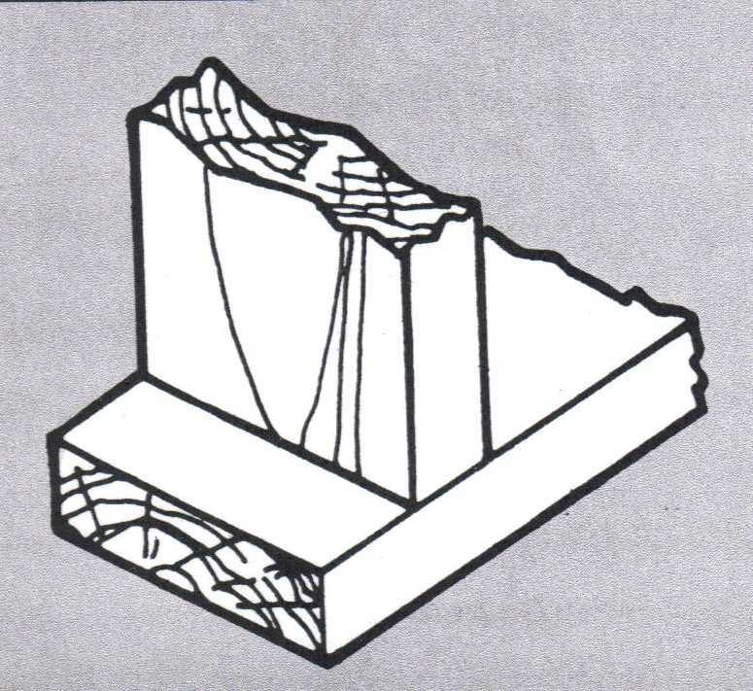
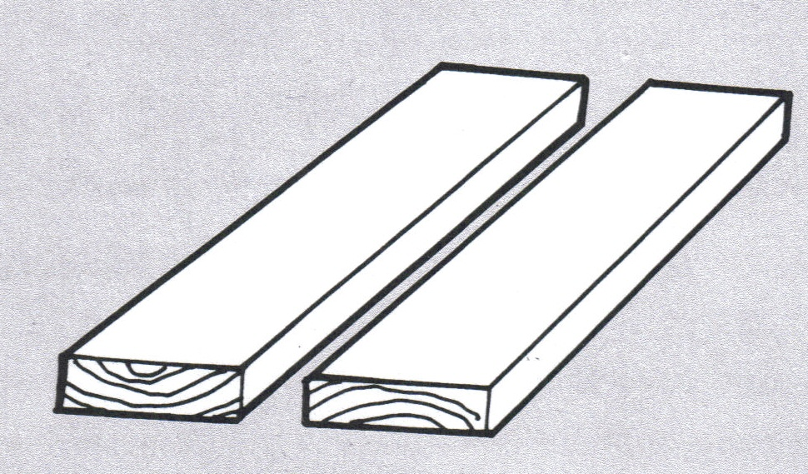
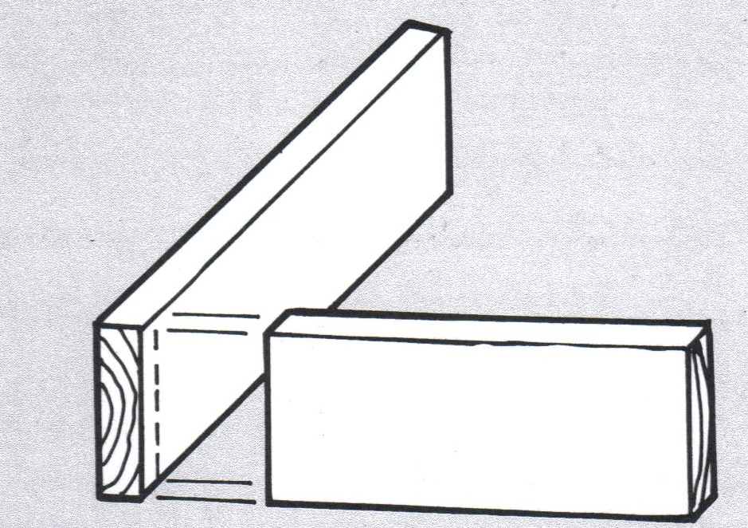
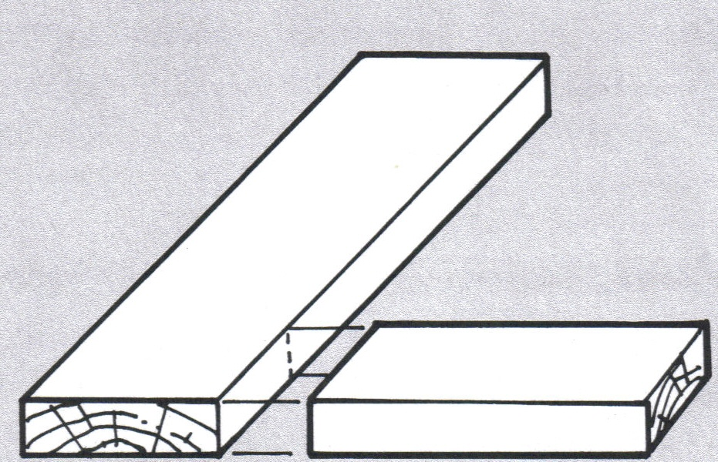
Wood joinery – butt joints

Slide 16
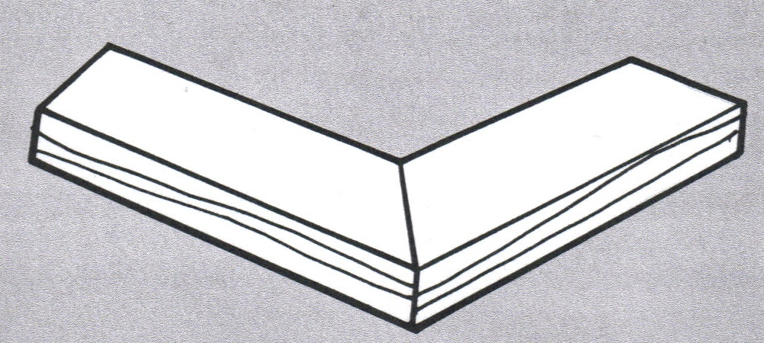
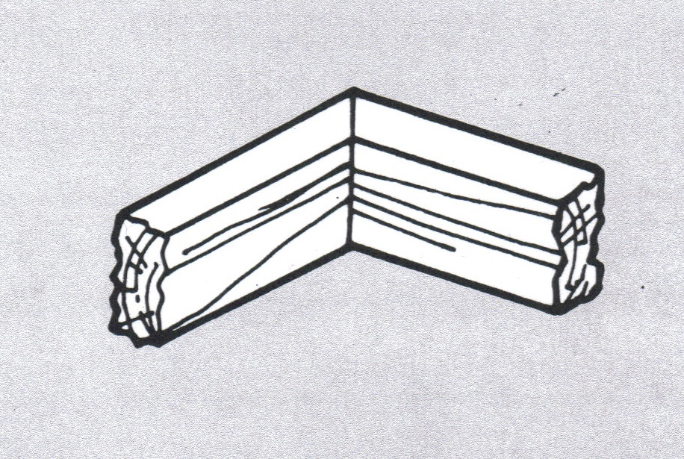
Wood joinery – miter joints

Slide 17
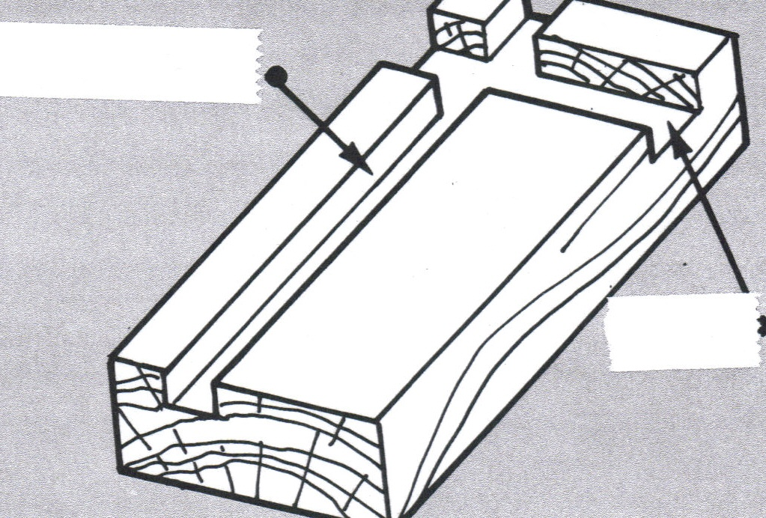
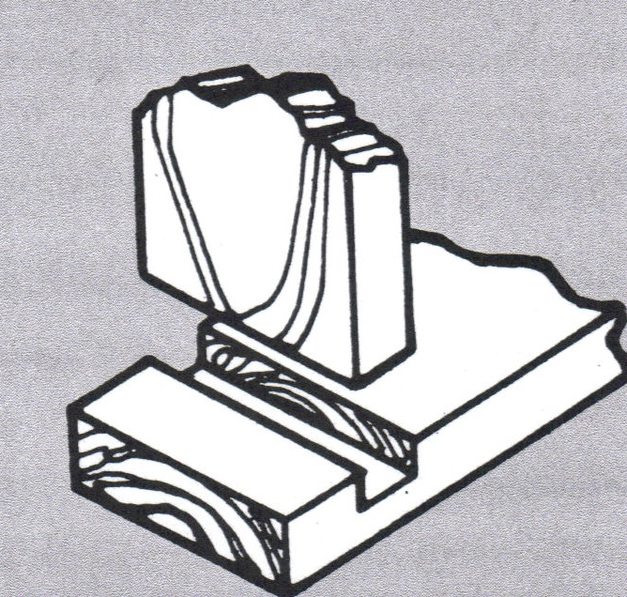
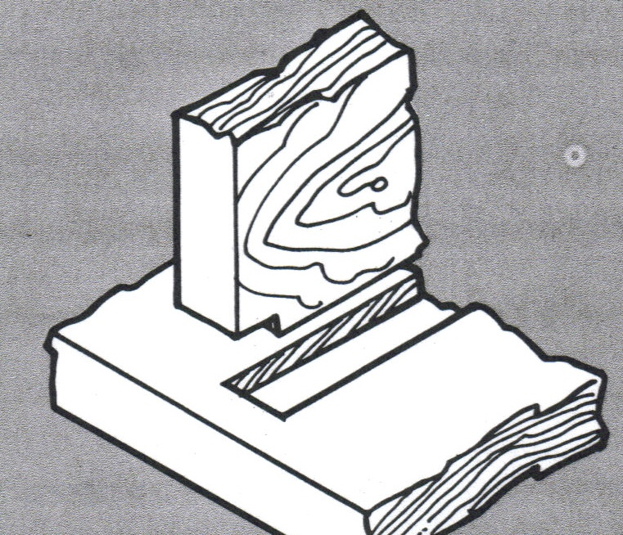
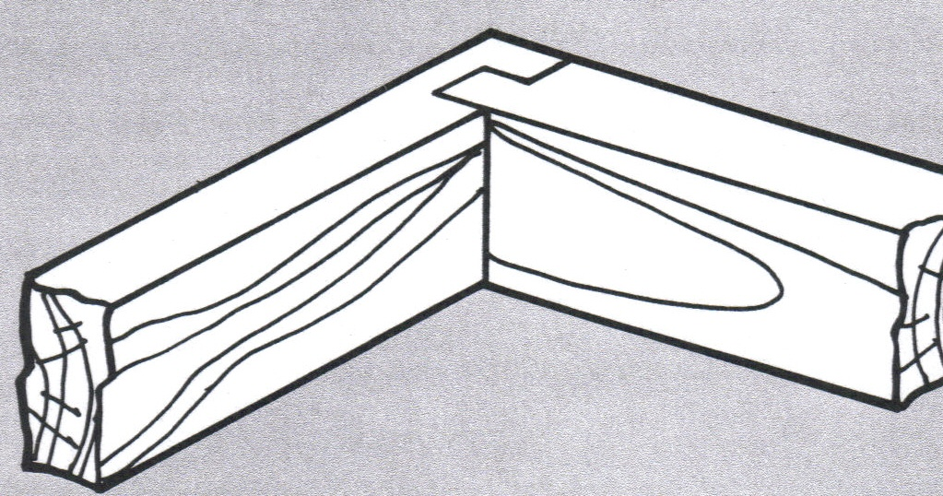
Wood joinery – dado joints

Slide 18
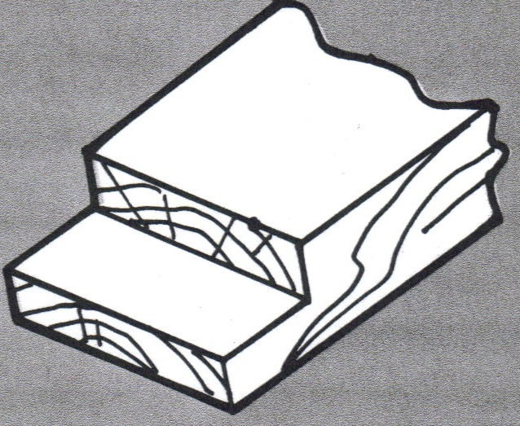
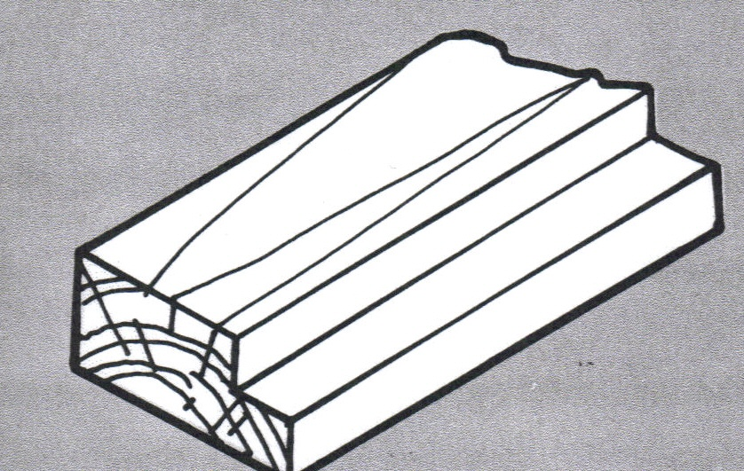
Wood joinery – Rabbet joints

Slide 19
Wood joinery – box/finger joints

Slide 20
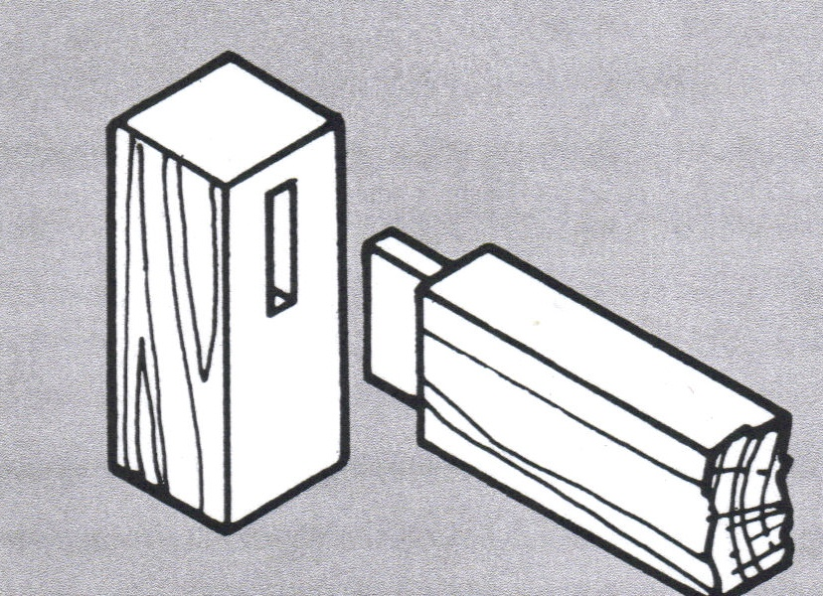
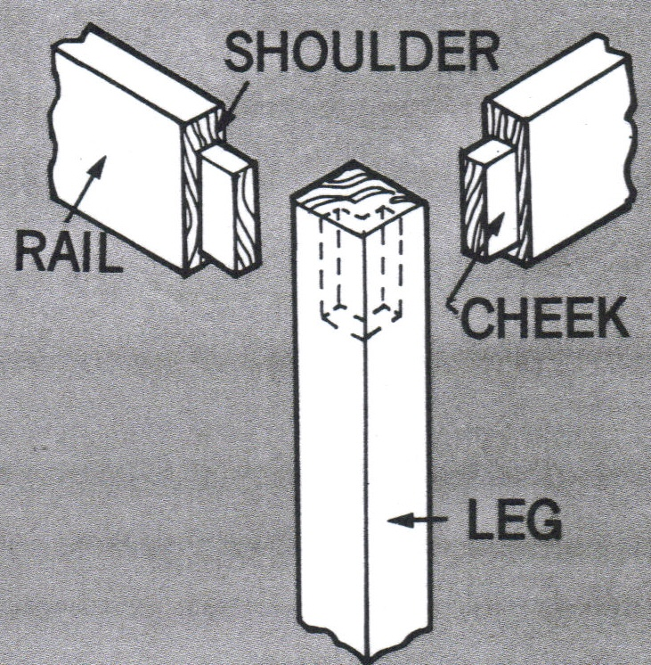
Wood joinery – mortise and tenon

Slide 21
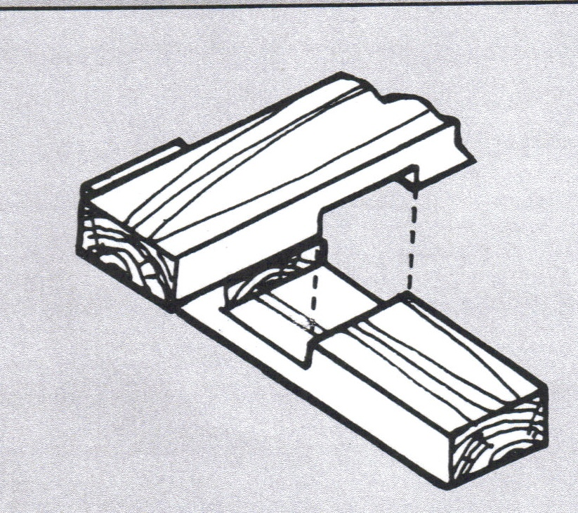
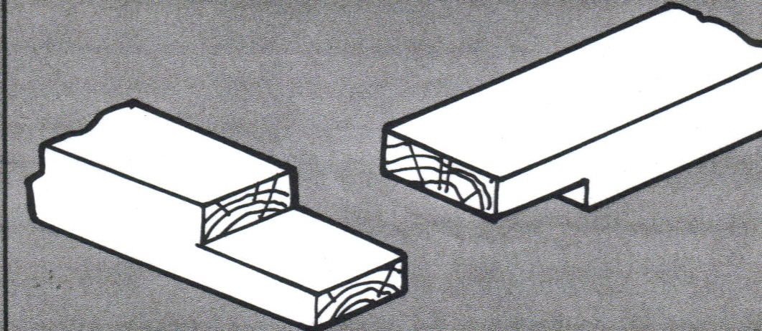
Wood joinery – lap joints

Slide 22
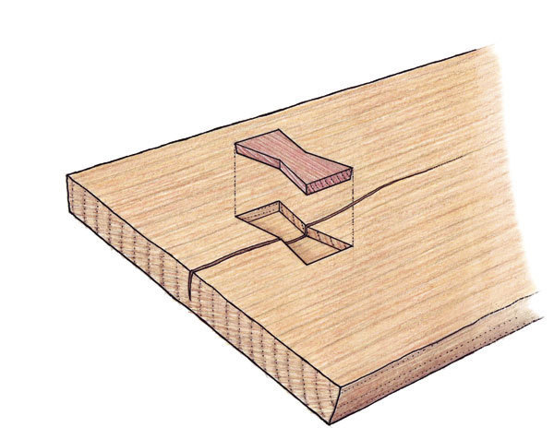
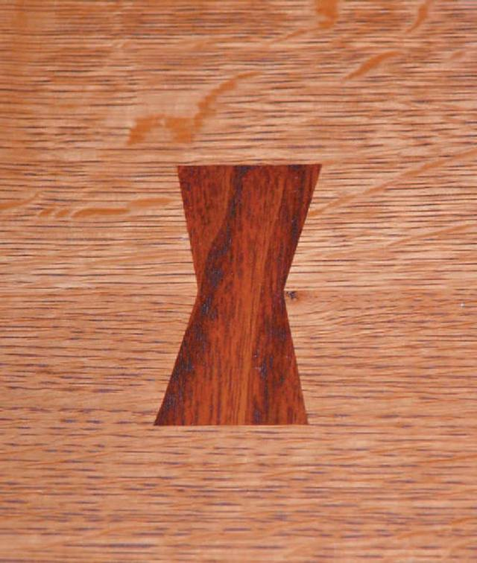
Wood joinery – butterfly joints

Slide 23
Wood joinery – dowel

Slide 24
Wood joinery – biscuit

