Slide 1
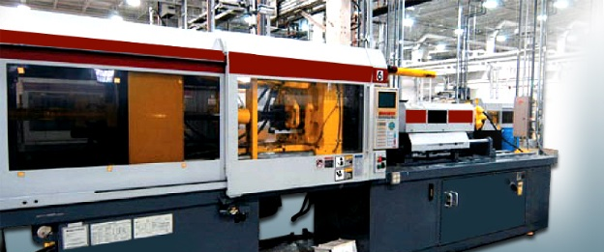
Wood materials
Mr. Maiseroulle

Slide 2
Trees
Perennial – lives more than two years
Wood plant that has a stem and grows to at least 20 feet.

Slide 3
Classifications
Hardwoods
Softwoods

Slide 4
Hardwoods
Angiosperms
Covered Seed
Deciduous
Leaves are shed during the fall season
Distinct in cell structure
Open or closed grain

Slide 5
softwoods
Gymnosperms
Open Seed
Conifers
Cone Bearing
Evergreens
Leaves are needle like
Resin Ducts

Slide 6
Tree structure

Slide 7
Wood identification
Visual Features
Physical Properties
Mechanical Properties
Thermal Properties
Chemical Properties
Acoustical Properties

Slide 8
Visual
Color
Sapwood
Heartwood
Figure
Grain
Smell
Taste?

Slide 9
Physical
Weight
Specific Gravity – weight per unit volume
Density
Porosity
Microscopic Exam – Only way to tell exact species, limited equipment

Slide 10
Mechanical
Hardness – Maple
Tensile Strength
Flexure Strength – Osage Orange
Impact Strength – Ash
Compression Strength – Spruce

Slide 11
Advantages of wood
Lightweight (for the most part)
High strength to weight ratio
Natural Beauty
Easy machinability
Multiple uses
Longlasting

Slide 12
Moisture content
MC - the amount of water in wood cells expressed as a percentage of the wood’s totally dry weight.
Can range anywhere from 30% to 200% before it has been dried or seasoned.
Wood actually gets smaller in size as it loses moisture and larger in size as it gains moisture.
Most of the size change in wood takes place across the grain (Width of Wood)
Little change in thickness
Virtually no change with the grain (Length of Wood)

Slide 14
Moisture content
Equilibrium Moisture Content- a balance in M.C. of wood with the surrounding air after it has been dried
E.M.C varies between 6 an 12%.
Hardwoods used to make furniture are dried down to a M.C. of 6 to 12%.
Softwoods used in home construction are dried down to a M.C. of 19%.

Slide 15
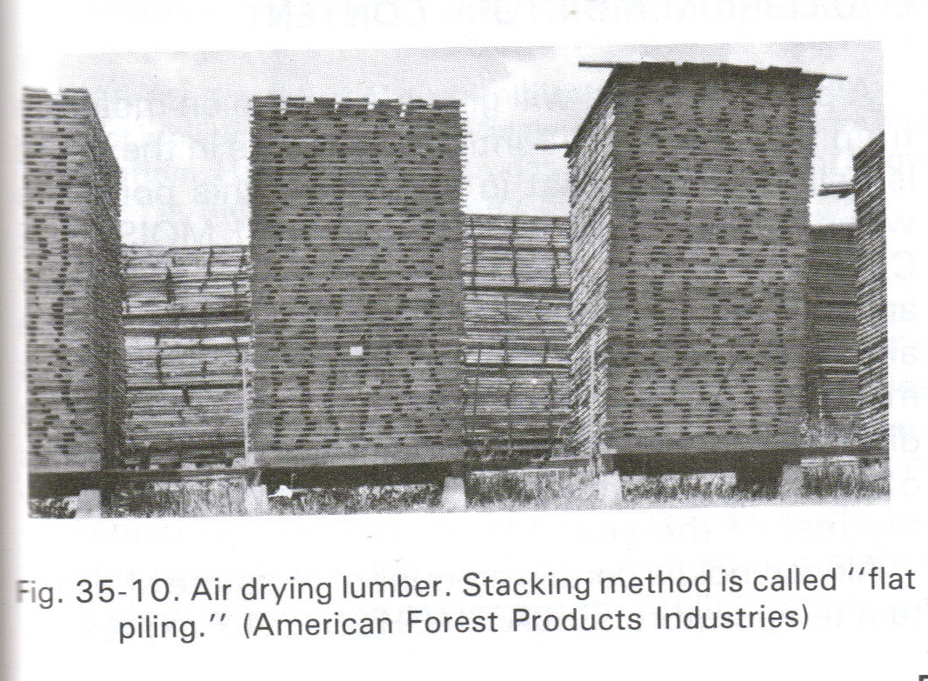
Air drying
Air-Drying- natural seasoning of wood done outdoors by the sun and wind which involves stacking boards with small strips of wood between each piece of lumber.
Inexpensive
Time Consuming
Uncontrolled Moisture Loss (Warps and Twists)
Only can dry down to between 18 & 20%

Slide 16
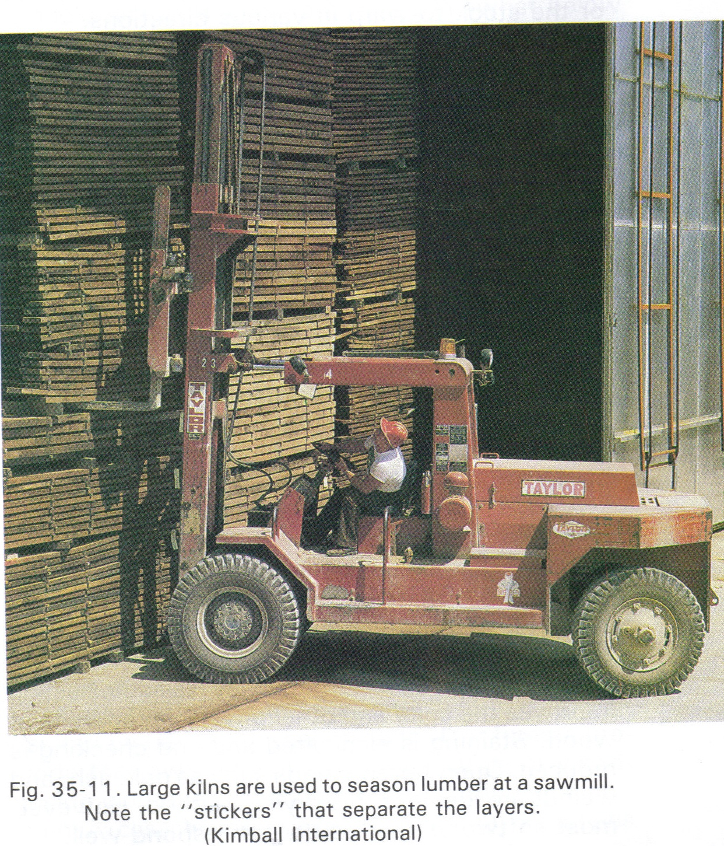
Kiln drying
Kiln Dried- seasoning process in which controlled heat is used to remove excessive moisture.
Heat from 110 to 180 degrees Fahrenheit
Lumber can be dried down to below 6%
Rate of moisture removal can be monitored

Slide 17
Lumber sizes
Lumber dimensions are listed in order of
T (Thickness) distance between the faces
W (Width) distance across the grain of the wood
L (Length) distance along the grain of the wood

Slide 18
Sale of wood
Board Feet:
# of pieces x T x W x L”
12 x 12 or 144
Square Foot: area
W x L
Lineal Foot:
Also known as running foot
Length of material in a straight line

Slide 19
Terminology
Rough Lumber (RGH)- lumber that has not been sawn, trimmed to width, and edged.
Surfaced Lumber- a couple or all surfaces of the board have been smoothed.
S4S- lumber that has been surfaced on four sides (dimensional lumber)
S2S- lumber that has been surfaced on two sides
Rip- Cutting wood with the grain
Crosscut- cutting wood across the grain

