Slide 1
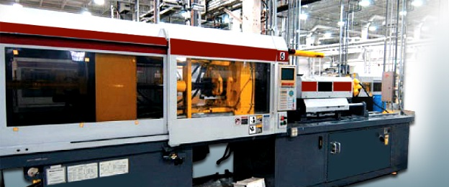
Welcome 8th Grade Investigations of Technology: Materials and Processes Technology
Mr. Maiseroulle

Slide 2
Any question on the syllabus?
Three rules
Be Safe
Be Respectful
Be Responsible

Slide 3
Schedule
Introduction to Materials
Measurement
Wood Materials
Wood Processes
Metal Materials
Metals Processes
Plastic Materials
Plastic Processes
Manufacturing Enterprise

Slide 4
Introduction to Materials: States of Matter
Solid
Liquid
Gas

Slide 5
Classification of Materials
Origin
Industrial Purpose
Organic
Inorganic
Engineering – makes something
Non-engineering – what goes into making something

Slide 6
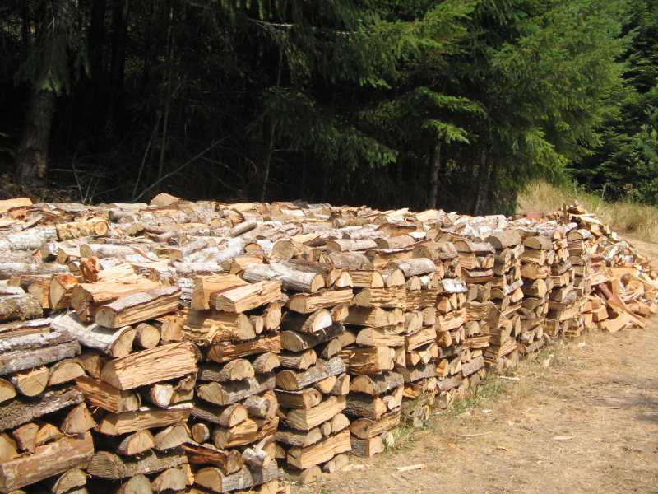
Renewable vs Nonrenewable
Renewable (Inexhaustible)
Nonrenewable (Exhaustible)

Slide 7
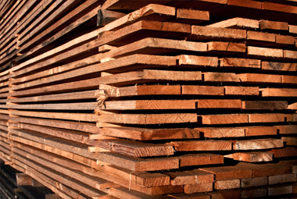
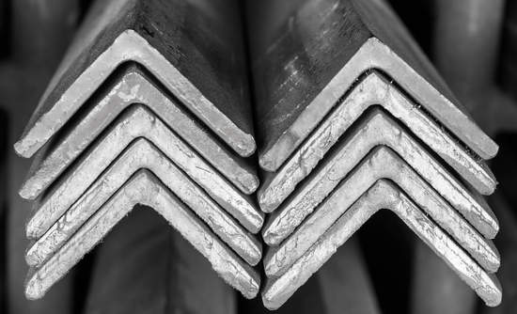
Types of Industrial Materials
Metals
Composites
Earth Materials
Polymers (Two Types)
Natural
Synthetic

