Slide 1
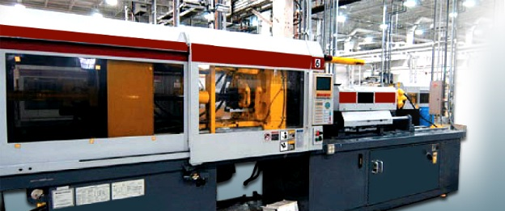
Metal Materials
Mr. Maiseroulle

Slide 2
Metals
Inorganic Substance
Expands when heated, contracts when cooled
Rarely used in pure form
Usually alloys (combination of metals)
Strong, durable, tough, and stable

Slide 3
Categories of Metals
There are two:
Ferrous
Metals which contain iron and carbon
Classification is based upon amount of carbon and the finish process
Steel – less than 1.7% Carbon
Cast Iron – more than 1.7% Carbon
Nonferrous
Metals that do not contain iron
Though some trace amounts of iron can be found as an impurity

Slide 4
Ferrous Metals
Wrought Iron – Very ductile, easily worked cold, high corrosion resistance.
Rivets
Low Carbon Steel – Tough, easily formed, machined and welded.
Bolts, Nails
Medium Carbon Steel – Strong and hard, not as easily forged or welded as low carbon.
Agricultural Machinery
High Carbon Steel – Responds well to heat treating to obtain any degree of hardness, temper or strength; special welding rods are required.
Screw Drivers, Pliers

Slide 5
Non-Ferrous Metals
Brass-alloy of copper and zinc, harder than copper.
–Hinges, screws, other hardware
Bronze-alloy of copper and tin, tough, wear resistant, highly corrosion resistant.
–Machinery parts, bearings
Aluminum-light weight, good strength, high electrical conductivity, excellent heat transfer, corrosion resistant.
–Trailers, airplanes, food handling equipment
Magnesium-lightest weight, has low strength in pure form, produces magnesium oxides when burned.
–Wheels, lawn mower frames

Slide 6
Non-Ferrous Metals
Zinc-used for galvanizing, very corrosion resistant.
Nickel-increases hardness and improves resistance to corrosion in steel.
Lead-heavy and soft, considered a health hazard
–Soldering
Tin-very high corrosion resistant.
–Solder, brass, bronze and pewter
Copper-excellent conductor of electricity and heat, very workable (ductile).
–Wire, water pipes, radiators
Tungsten-high melting point, tungsten carbide is very hard.
–Cutting and piercing tools

Slide 7
Non-Ferrous Metals
Silver-very soft, excellent conductor of electricity; sterling silver is 92.5% silver and 7.5% copper.
–Metal alloys
Gold-24 karats is pure gold.
–Plating and jewelry

