Slide 1
Hand Tools
Intro to Industrial Tech

Slide 2
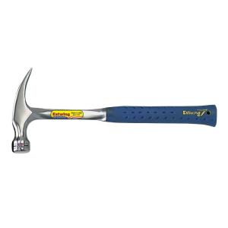
Nail Hammer
Curved Claw: Used to pound in nails and the claw to pull nails.
Straight Claw: Used to pound in nails and the claw to deconstruct or frame.

Slide 3
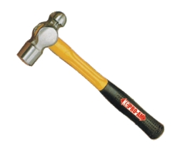
Ball Peen Hammer
Used to:
Shape sheet metal
Forging (Heat shaping metal)
Peening (conditioning)

Slide 4
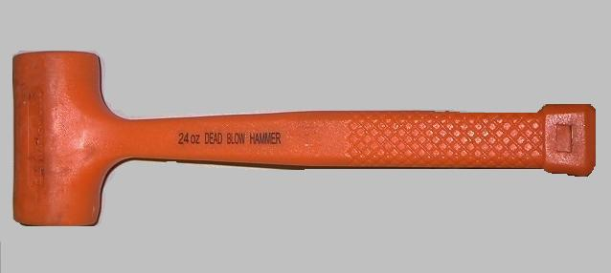
Assembly Mallets
Used to:
Align pieces for assembly.
Driving in wood pins.
Used with wood chisels.
Dead Blow: is for powerful persuasion.

Slide 5
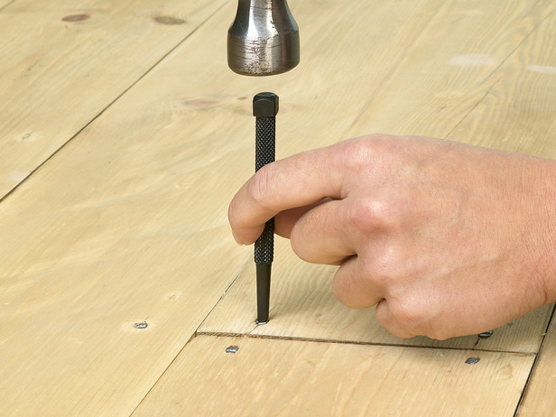
Nail Set
Drives nails below the surface for filling.
Used in conjunction with a nail hammer.

Slide 6
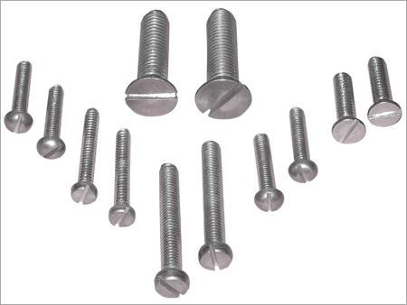
Standard (Straight) Screwdriver
Used to turn slotted screws.
NOT A PRYBAR or CHISEL!!!!!!

Slide 7
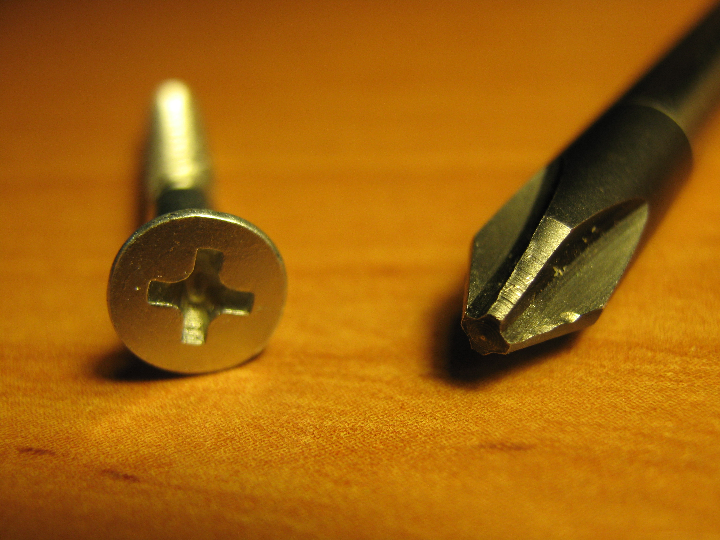
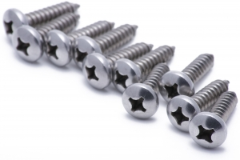
Phillips (Recessed) Screwdriver
Used to turn Phillips drive screws.

Slide 8
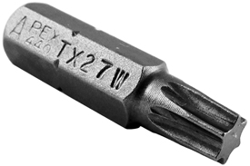
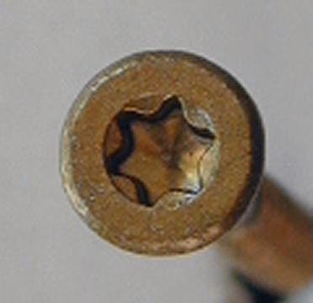
Torx Screw Driver
Used to turn torx drive (star) screws.
Lesser slipping of screwdrivers.

Slide 9
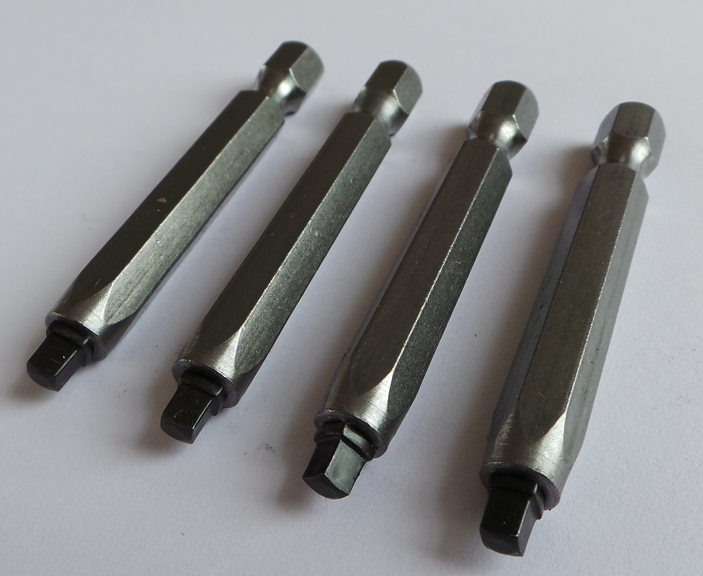
Square (Robertson) Screwdriver
Turns in square drive screws.
Equal to torx as far as grip.

Slide 10
Try Square
Used for:
Square lines
Precision layout

Slide 11
Combination Square
Uses:
Precision measuring
Locks in place for multiple measurements.
45 degree angle
Spirit level
Squaring lines
3/8” measuring

Slide 12
Scratch Awl
Used to scribe (scratch) sheet metal.

Slide 13
Steel Rule
Precision measurements.
Straight edge

Slide 14
Measuring Tape
Used for long distances.

Slide 15
Speed Square
Used in framing houses.
Quick way of squaring lines

Slide 16
Carpenter’s Square
Used in construction framing rafters and stairs.

Slide 17
Part 2

Slide 18
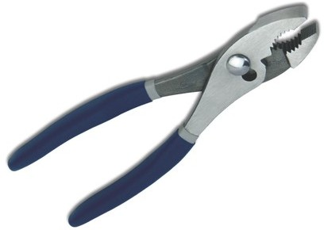
Slip Joint Pliers
Most Common type
Multi-use:
Holding bolts/nuts
Fencing
Wiring
2 sizes

Slide 19
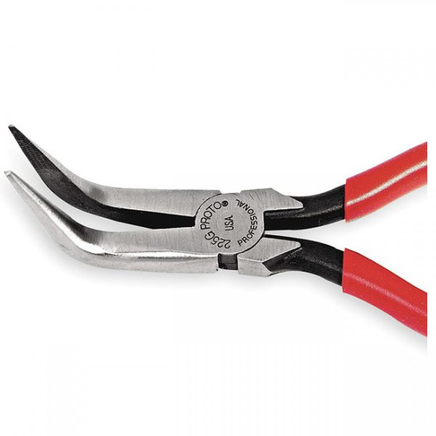
Long Nose Pliers
Needle Nose Pliers
Used:
Electricians
Mechanics
Fishing

Slide 20
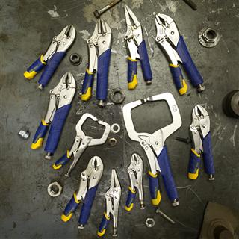
Locking Pliers
Also known as Vice Grips (vice grip is a brand)
Used to clamp onto things.

Slide 21
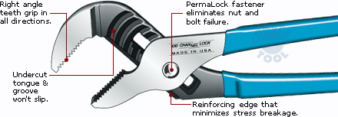
Tongue and Groove Pliers
Know commonly as channel locks
Used extensively by plumbers

Slide 22
Lineman Pliers
Used by electricians and lineman

Slide 23
Hemming Pliers
Used to hand bend sheet metal tabs and hems.

Slide 24
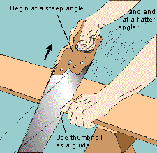
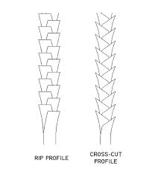
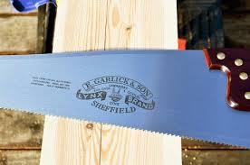
Hand Saws
Powered by the arm/hand.
Cross cut, finer teeth.
cuts across the grain
Rip saw: larger teeth:
Cuts with the grain

Slide 25
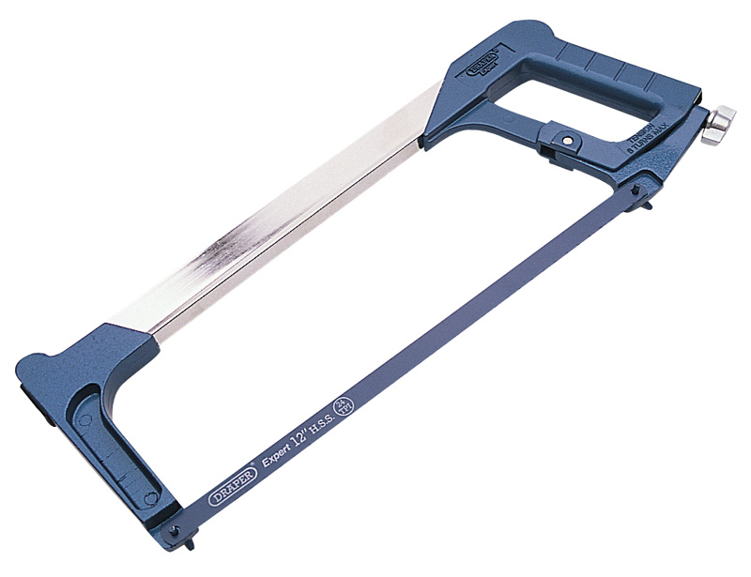
Hand Saws
Coping Saw: cuts curves
Hack Saw: cuts metal, fine teeth

Slide 26
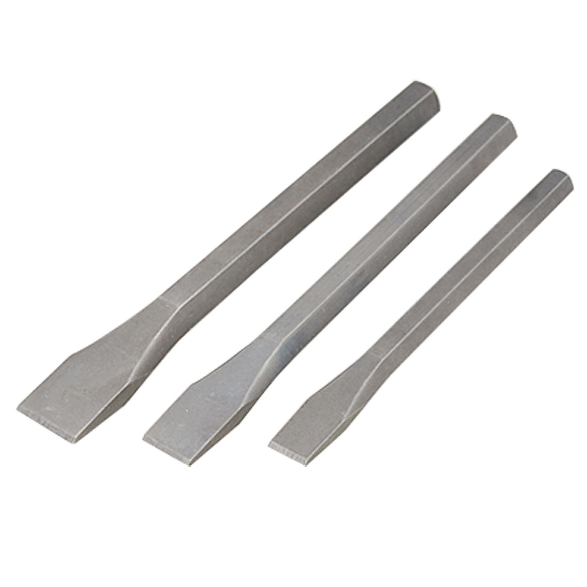
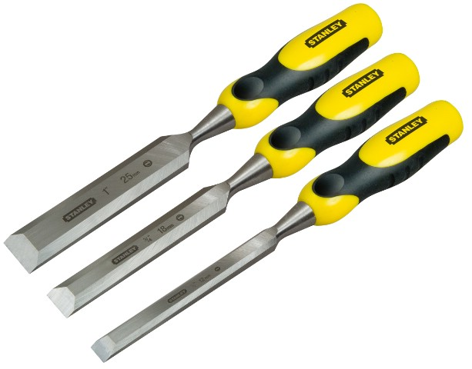
Chisels
Cold Chisel: used with ball peen hammer on metal.
Wood Chisel: used with mallet on WOOD!

Slide 27
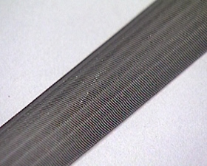
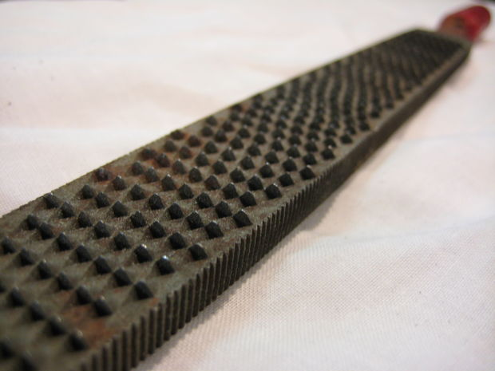
Files/Rasps
File: smaller teeth used to smooth or remove excess material.
Rasp: used to remove a lot of material quickly. Only softer materials.

Slide 28
Metal Shears
Used to cut sheet metal. Used just like scissors.

Slide 29
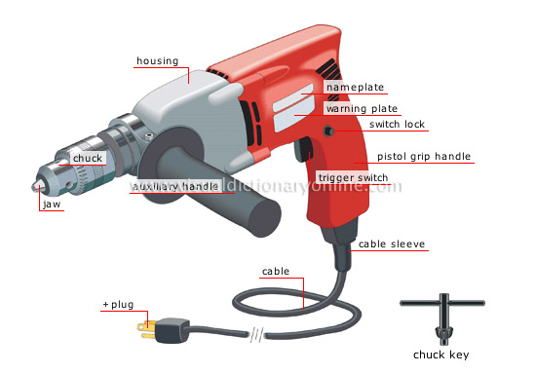
Drills
Portable Power Tools
Cordless: runs on battery
Corded: plugs into an outlet

Slide 30
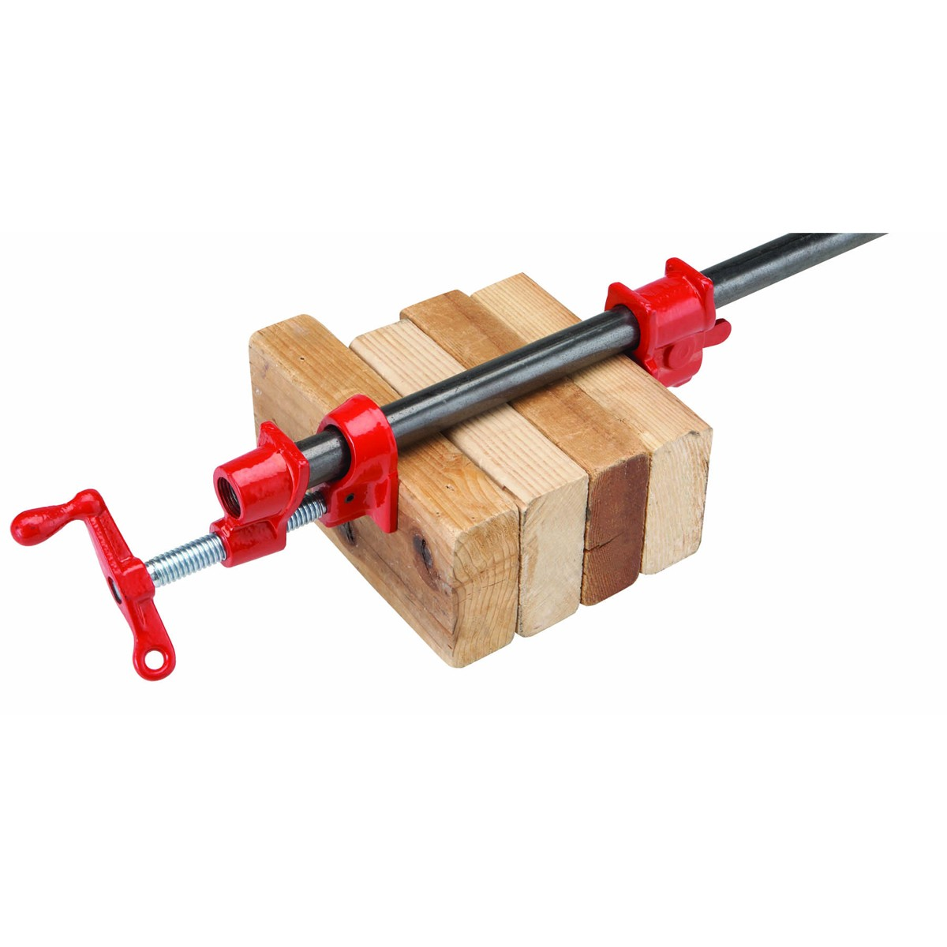
Clamps
Bar Clamps & Pipe Clamps
Used to clamp materials together.
Used with larger materials.

Slide 31
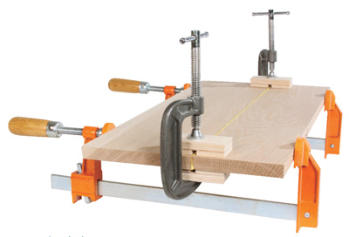
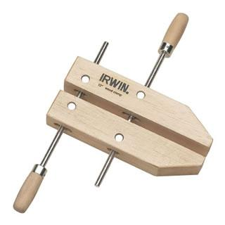
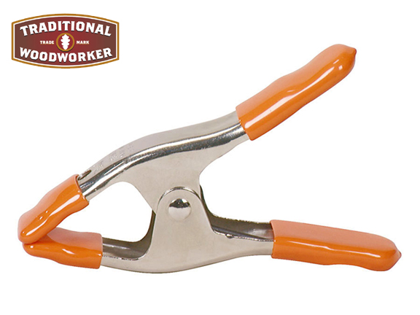
Clamps
C-Clamp: very strong
Wood Clamp: clamp smaller pieces or jigs
Spring Clamp: smaller pieces

Slide 32
Spot Welder
Used to fasten metal together:
Uses electrical Resistance

